Slide 1
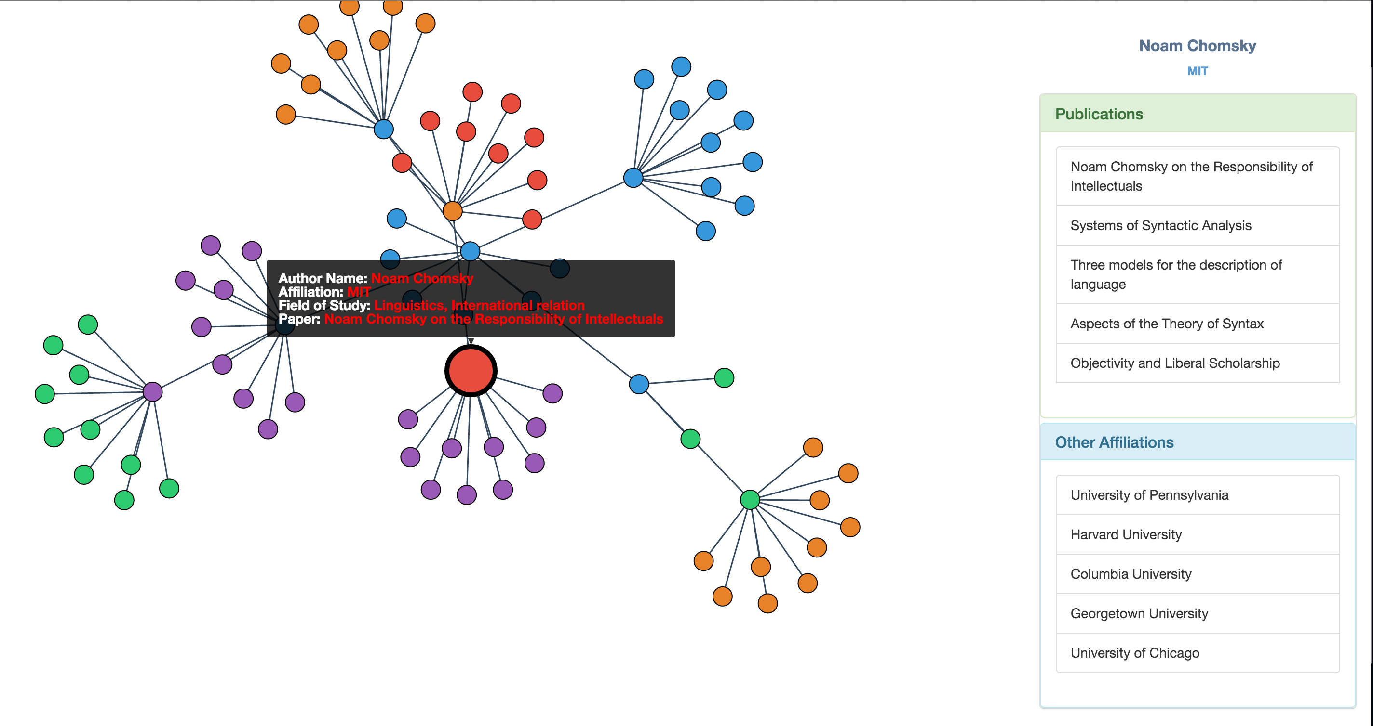
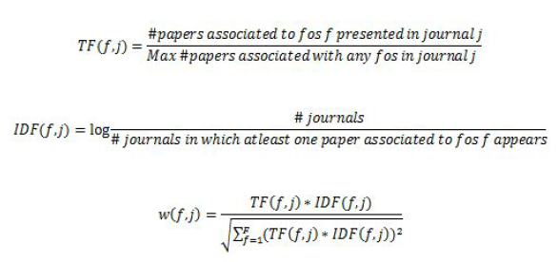
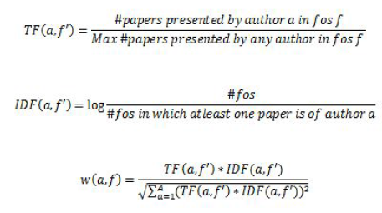

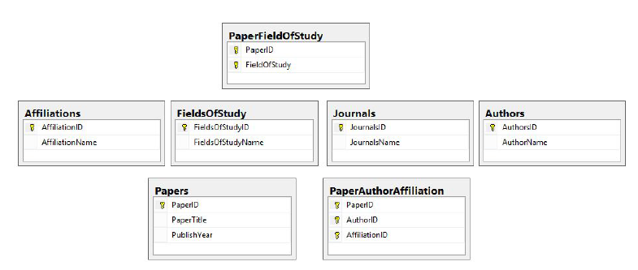
Scholar’s search engine:
A scholar’s search and visualization System
Pradeep Vairamani, Ankita Jain, Ashish Kumar,
Shubam Agrawal and Ashita Prasad
Motivation/Introduction
USER INTERFACE
BACKEND DATA PROCESSING
The Scholar’s Search Engine is an alternative to existing academic search engines, with better organization and visualization for similar scholar’s based on a wide range of features such as field of study, papers, collaborations etc. It is targeted towards the research community to help them explore researchers in an easy and meaningful manner by expanding their network. We hope that this project can lead to a more open and collaborative research environment, where people can find researchers with similar interests easily.
Currently researchers use text based academic search engines which are not particularly intuitive or easy to use. One of the limitations of current practice is that search results only show papers, without showing other researchers working on similar topics. We intend to make it easy for users to find similar researchers with an easy to use bubble based visualization
1) Data Source : Microsoft academic search
2) Total uncompressed data size : ~50GB
3) Total number of scholars:
a) Before filtering : ~125 Million
b) After filtering : ~6 Million
4) Number of fields of study : 50,000
The high level architecture of our content based recommender system has the following components:
1. Content Analyzer: This component is responsible for converting the raw data to a structured information representation. This is one of the pre-processing steps which is needed to convert the original information space to vector space model (VSM) by extracting features.
2. Filtering Component: This component utilizes user input and suggests the most relevant items by matching the user input against the items to be recommended by computing the similarity metrics.
Item Representation as Vector Space Model For reducing field of studies, we find the weights of each field of study in various journals. TF-IDF is used as follows:
Normalized weight vectors using TF-IDF showing their degree of association to the particular field of study:
APIs
Information about data
Backend Framework : We have implemented the framework for the UI to talk to the data. There is a python server using the bottle library which will handle the API calls. The server can also handle Cross-origin resource sharing.
The 3 APIs that will be used are :
/similar/<author_id> Which returns a json with 10 similar authors with some metadata about each author.
2) /details/<author_id> This API returns the details about the individual author. This information is used to populate the sidebar.
3) /search/<author_name> This API is used to populate the first node based on a query in the search bar.
Similarity Measures: Once, we have vector representation of all authors, we will compute the cosine similarity among queried author and other authors as follows:
DATA MODEL
References
Experiment and results
Włodzisław Duch, “Similarity­ based methods: A general framework for classification, approximation and association”
Nitin Agarwal, Ehtesham Haque, Huan Liu, and Lance Parsons Arizona State University, Tempe AZ 85281, USA ­ “Research Paper Recommender Systems: A Subspace Clustering Approach”
Evaluation of similarity : We added dummy replica users and changed the name, id and one of the attributes and verified that our system returns this dummy user among the most similar scholars.
Verified for 1000 api calls that for 90% of the results there was at least one similar scholar with a publication that is less than one year old.
Manually verified most of the field of study clusters to make sure that there are no classification anomalies.

